Slide 1



KONGU ENGINEERING COLLEGE
(AUTONOMOUS)
PERUNDURAI, ERODE - 638060
Department of Computer Science and Engineering
RetinaGuard: A Clinical Decision Support System for the Diagnosis of Retinitis Pigmentosa
PRESENTED BY:
23CSR110 - KIRAN SEKAR C
23CSR119 – LOKESH P
23CSR124 – MANOJ P
Notes:
9/11/2024
1
1-59

Slide 2

PROBLEM STATEMENT
Retinitis Pigmentosa (RP) is a rare genetic eye disease leading to severe vision loss and blindness.
Current deep learning models often work only on clean, ideal datasets and fail in real-world clinical images.
Traditional AI is a “black box” and can misdiagnose:
Existing systems fail to detect RP variants like:
They also cannot adapt well to low-quality images from affordable handheld cameras.
camera flash artifacts
stitched image borders
unrelated diseases such as AMD and Diabetic Retinopathy
Sine Pigmento
Sectoral RP
Notes:
9/11/2024
2
1-59

Slide 3
OBJECTIVE
Build a reliable RP diagnosis system for real clinical and low-quality images
Make the diagnosis explainable and clinically interpretable, not a black-box AI
Detect rare RP variants like Sine Pigmento, RPA, and Sectoral RP
Avoid false positives from camera artifacts, flash, and unrelated retinal diseases
Support affordable handheld and smartphone fundus cameras
Provide clear clinical guidance, monitoring recommendations, and differential diagnosis
Notes:
9/11/2024
2
1-59

Slide 4
LITERATURE SURVEY
Existing Work | Method | Limitation
CNN-based Retinal Disease Detection | Deep learning on fundus photographs | Trained on clean datasets; poor real-world performance
ResNet & EfficientNet | Transfer learning with data augmentation | Black-box predictions with limited explainability
Hybrid AI Systems | OpenCV-based feature extraction | Poor detection of rare RP variants
Feature-based RP Analysis | Rule-based clinical decision engine | High false positives; no robust differential diagnosis
Notes:
9/11/2024
3
1-59

Slide 5
RESEARCH GAP IDENTIFIED
Existing System
DCNN-based disease classification only.
Binary RP prediction. Black-box AI models.
Poor performance on real-world images.
Rare RP variants not handled.
Proposed Research Gap
Hybrid Explainable AI + Clinical Rules.
Differential diagnosis support.
Artifact & image quality filtering.
Rare RP variant detection.
Intelligent monitoring recommendations.
Notes:
9/11/2024
4
1-59

Slide 6
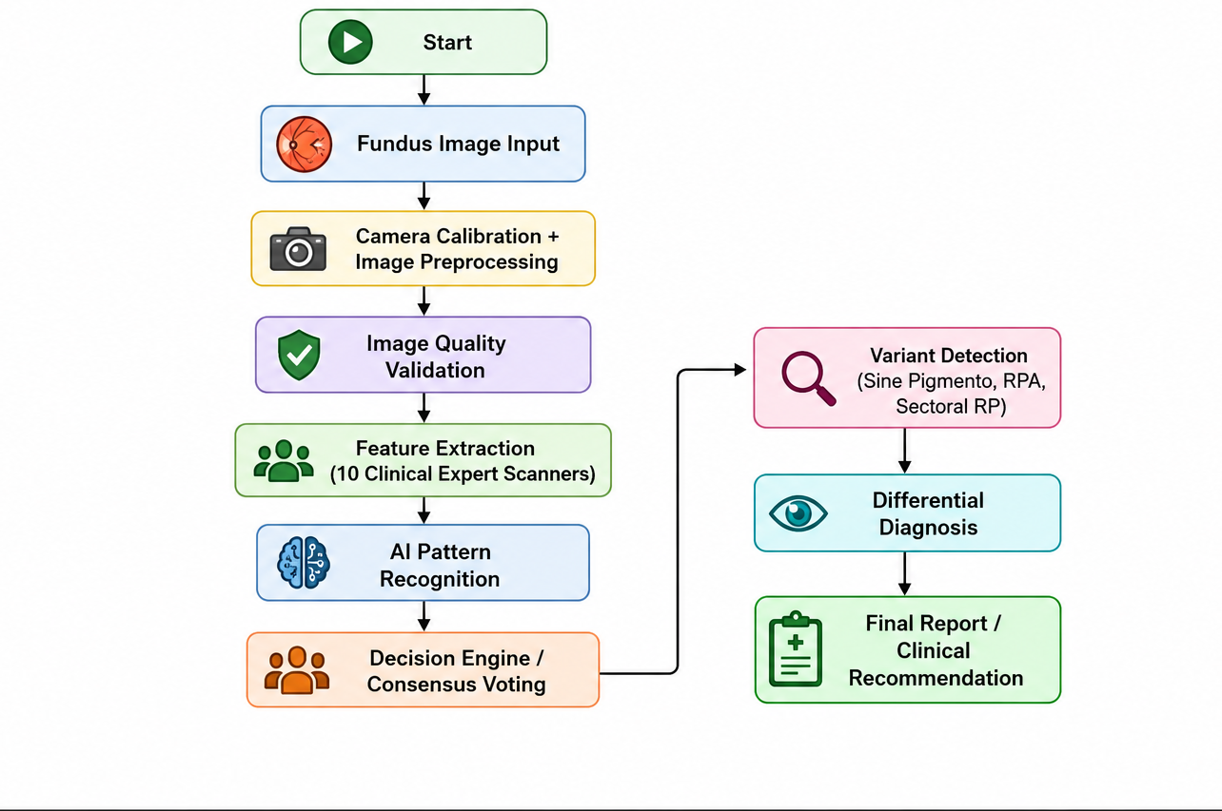
PROPOSED ARCHITECTURE
Notes:
9/11/2024
5
1-59

Slide 7
PROPOSED WORK WITH PLANNED INNOVATION
Proposed Work
Curate clinical dataset of color fundus retinal images.
Implement baseline Convolutional Neural Network (CNN) architecture for pattern recognition.
Develop a 10-Expert Computer Vision feature extraction suite (Vessel Attenuation, Pigmentation, Optic Disc Pallor).
Integrate a rules-based Clinical Decision Engine for automated consensus.
Notes:
9/11/2024
5
1-59

Slide 8
Planned Innovation
10-Expert White-Box Rule Engine: Shifting from uninterpretable "black-box" deep learning to clinical transparency.
WGAN-GP Synthetic Data Generation: Overcoming extreme data scarcity for rare genetic RP variants (Sine Pigmento, Sectoral RP, RPA) using Generative Adversarial Networks.
Color-Space Pathological Filtering: Utilizing LAB/HSV isolation to mathematically filter out camera flash artifacts and separate melanin pigments from diabetic blood hemorrhages (Differential Diagnosis).
Notes:
9/11/2024
5
1-59

Slide 9
MODULES OF THE PROJECT
Image Quality Validator (IQV) & Calibration Module
10-Expert Anatomical Feature Extraction Module
Deep Learning Core Classification Module (CNN)
Patient History & Clinical Risk Profiler Module
8-Rule Decision Engine & Differential Diagnosis Module (Novelty)
Explainable AI (XAI) & FDA 510(k) Report Generator (Novelty)
Clinical Dashboard & Interface Module
Notes:
9/11/2024
3
1-59

Slide 10
IMPLEMENTATION
Literature Survey & Medical Guidelines
Dataset Collection & Image Synthesis
Image Quality Filtering
Feature Extraction Code Development
Deep Learning Model Development
Diagnostic Rule Engine Setup
Model Evaluation & Testing
GitHub Upload & API Deployment
Notes:
9/11/2024
3
1-59

Slide 11
Intermediate Results
Metric | Value
Training Images | 480
Validation Images | 120
Accuracy | 91.00%
Precision | 89.02%
Recall | 87.00%
F1 Score | 88.28%
Notes:
9/11/2024
3
1-59

Slide 12
FUTURE SCOPE
Connect the Flask API backend to the interactive Glassmorphism React/Web UI dashboard.
Conduct multi-site clinical trial validation to establish FDA.
Secure sharing of diagnoses and patient data with specialists for remote collaborative diagnosis and treatment planning.
AI-driven predictive models to forecast disease progression rates and personalize patient treatment timelines.
Notes:
9/11/2024
3
1-59

Slide 13
THANK YOU
Notes:
9/11/2024
3
1-59

